Slide 1
MTH208 Group Project, Group 25
A Deep-dive into YouTube’s Global Trends
Instructor: Dr. Dootika Vats
Prashant Shekhar
Kunal Dayma
Bharat Dhawal
Ahammed Ikbal

Slide 2
1. What are we doing?
We want to produce an overview of what viewers all across the globe are watching.
What are their consumption patterns? How do things vary from country to country?
2. What have we collected?
We used YouTube’s API to fetch the necessary data. YouTube has a large amount of data, and we have chosen to gather data from its trending section.
3. Why have we chosen the Trending section of YouTube?
YouTube’s trending section lists the videos that are widely viewed by users, making it perfect for analyzing to generate meaningful insights that align with our motto.

Slide 3
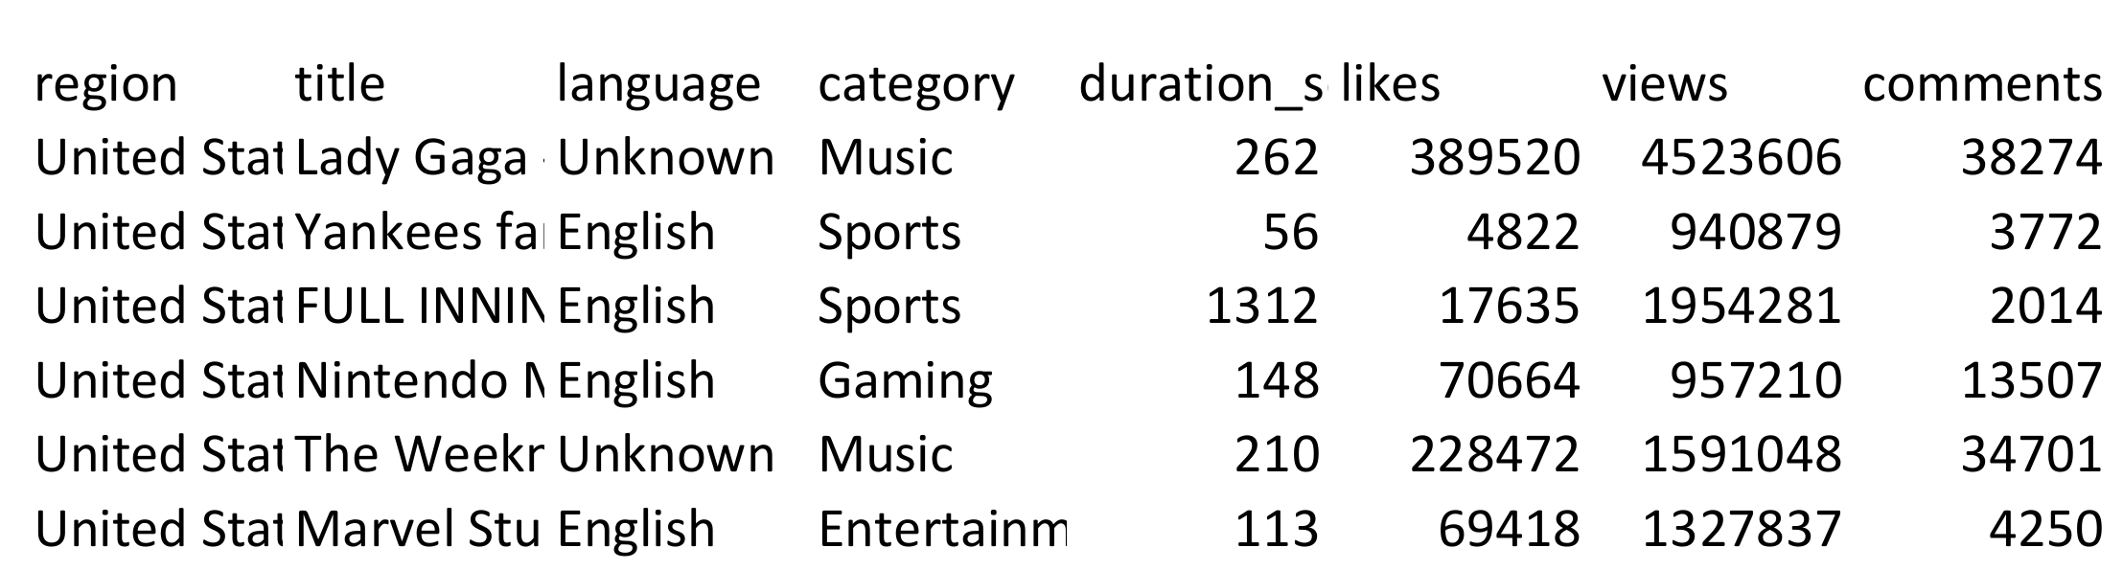
4. About Our Data
We have data for all the videos listed in YouTube’s trending section for 15 countries, e.g. India, Japan, Italy, Russia, Indonesia, Germany, US, UK, etc. over 33 different languages, e.g. English, Korean, Spanish, Romanian, Hindi, Odia, Tamil, Russian, Arabic, etc. and spread across 15 categories e.g. Music, Gaming, Education, etc. We have gathered ‘Engagement’ i.e. likes, views, and comments as well as the duration of each video. Data is collected on Oct 31 2024 16:47:14 (India Standard Time).
5. Sample of our dataset

Slide 4
6. We posed the following questions based on the data
What are the countries that have similar tastes in videos?
Do more views increase likes and comments?
Do higher view counts increase the likelihood of entering the trending section?
What content are people watching in different countries?
What are the categories where short-form content is preferred? Same question for long-form content. How does it vary over different countries?
In which languages do people watch content in different countries?

Slide 5
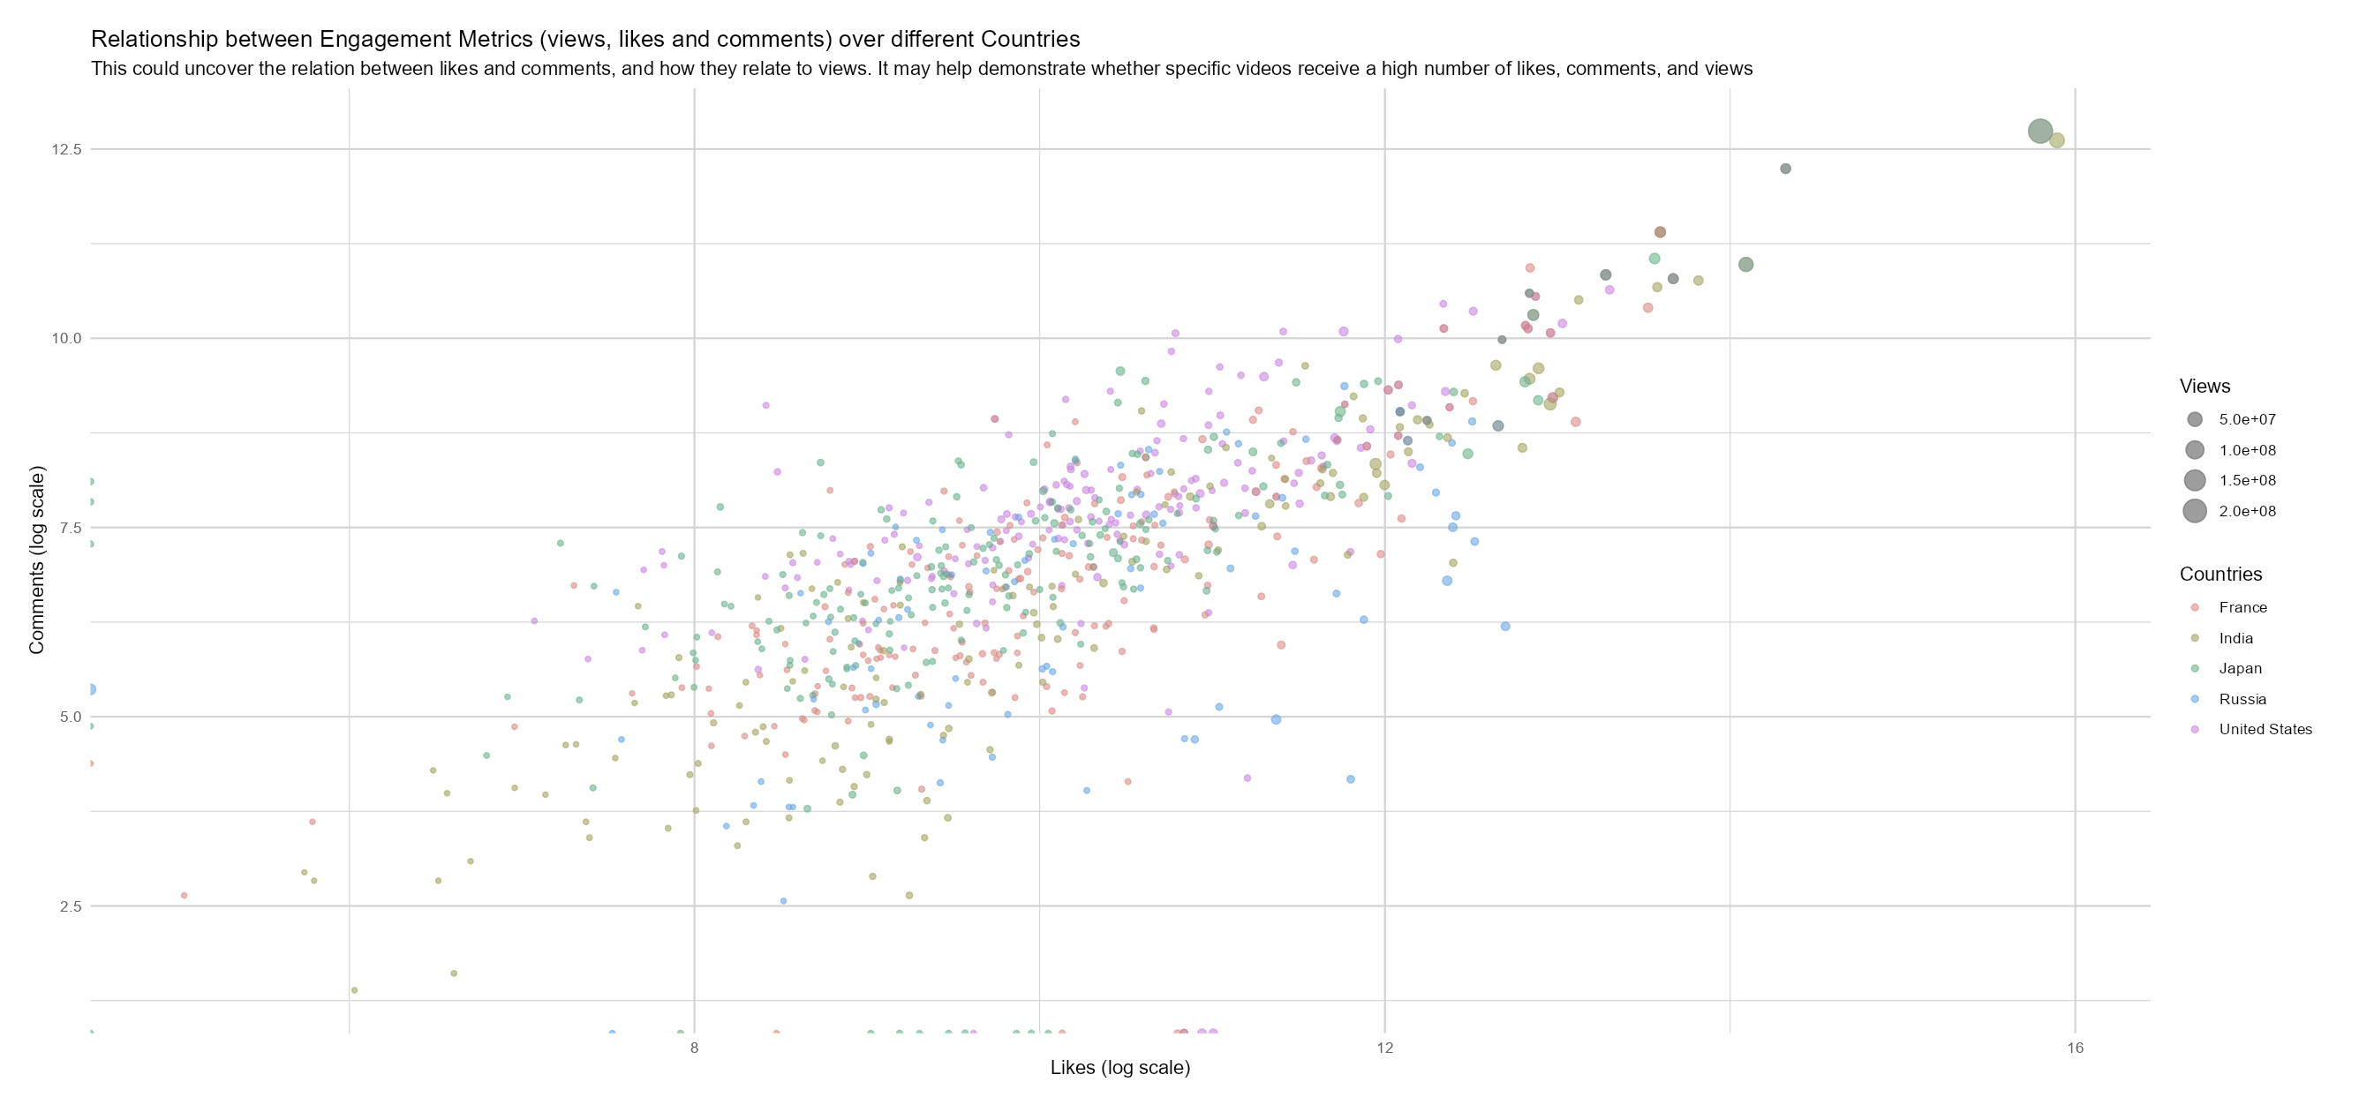
Do more views increase likes and comments?
There is a positive correlation between views, likes, and comments. While this may not apply generally, YouTube tends to feature videos with high engagement in its trending section, which makes sense.

Slide 6
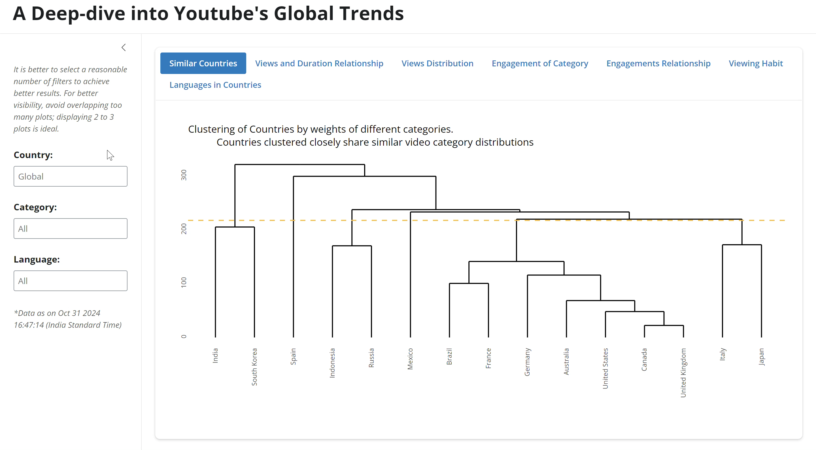
7. Demo of our Shiny App

Slide 7
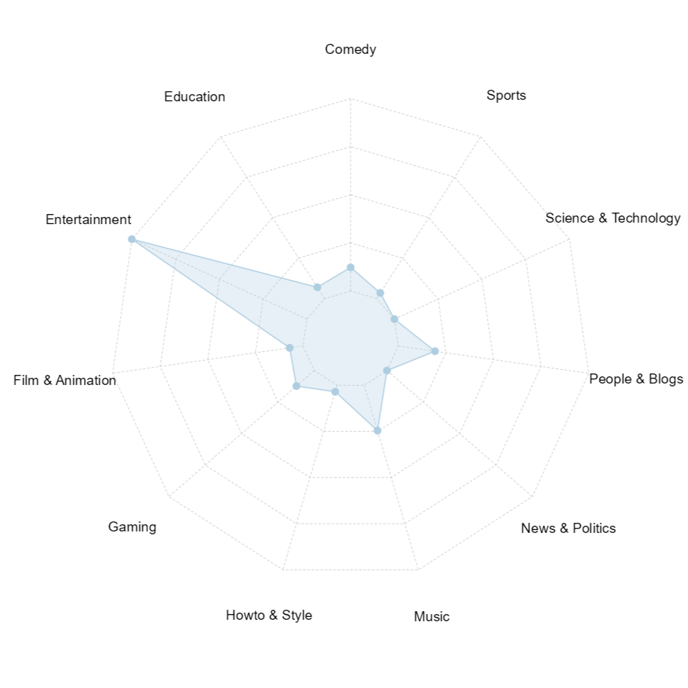
8. What Indians are watching?
The chart indicates that Indians primarily use YouTube as an entertainment app.
What about you?

Slide 8
Thank you.

